Slide 1
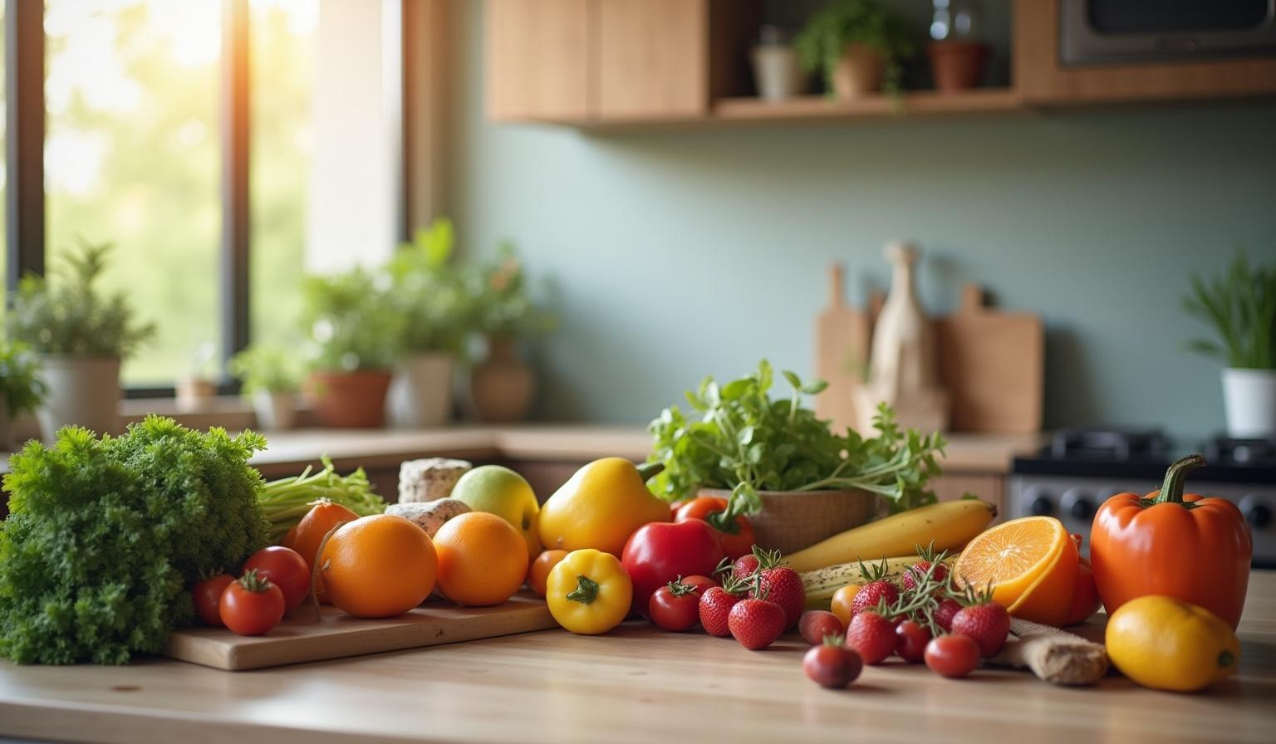
College name: Seshadri Roa Gudlavalleru Engineering College Track name: Artificial Intelligence and Machine learning Team lead: Chalamalasetti Dharani Team members:bhanu prakash ,harinayak
Smart Sorting: Transfer Learning for Identifying Rotten Fruits And Vegetables

Slide 2
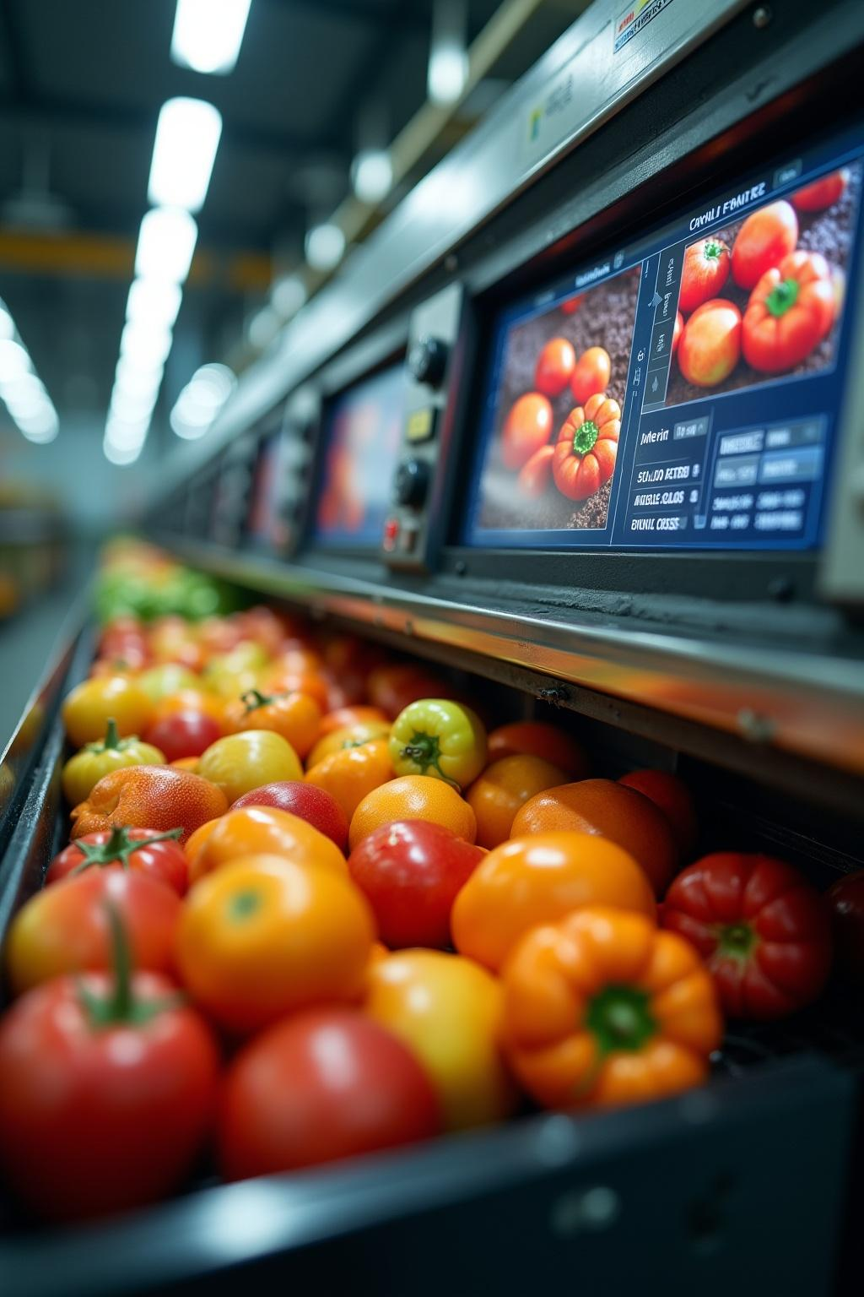
Introduction
NutriGaze is an AI-powered web application that helps identify whether fruits and vegetables are healthy or rotten just by analyzing an image. It uses a deep learning model trained to detect 28 categories of produce and classify them accurately.
This project aims to reduce food waste, support farmers and vendors, and ensure quality control in the food supply chain by providing instant and reliable predictions using modern technology.

Slide 3
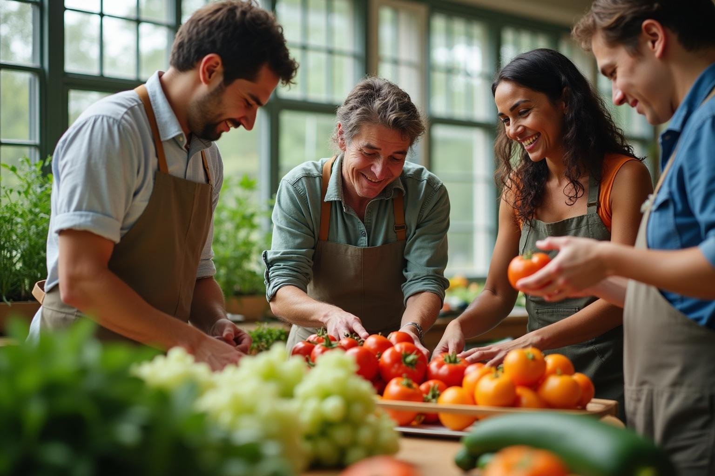
Project objective
Identify Rotten Fruits & Vegetables Use AI to check if a fruit or vegetable is fresh or rotten.
Support Many Types of Produce Works for 28 types of fruits and vegetables.
Help Farmers and Shopkeepers Makes it easier for them to know which items to remove or sell.
Reduce Food Waste Finds rotten items early to avoid throwing away fresh ones.
Quick & Easy to Use Just upload a photo and get results instantly.
Use AI for Agriculture Show how smart technology can help in farming.

Slide 4
Data Collection and Augmentation
Data Collection
Source: Public datasets (e.g., Kaggle, Google Images).
Classes Collected: 28 categories (e.g., Apple __ Healthy, Apple __ Rotten, Banana __ Healthy, etc.)
Type of Images: Real-world images of fruits and vegetables — both healthy and rotten.
Format: JPEG/PNG images in folder structure.
Data Augmentation
To avoid overfitting and improve model generalization:
✅ Rotation
✅ Zoom
✅ Flip
✅ Shift

Slide 5
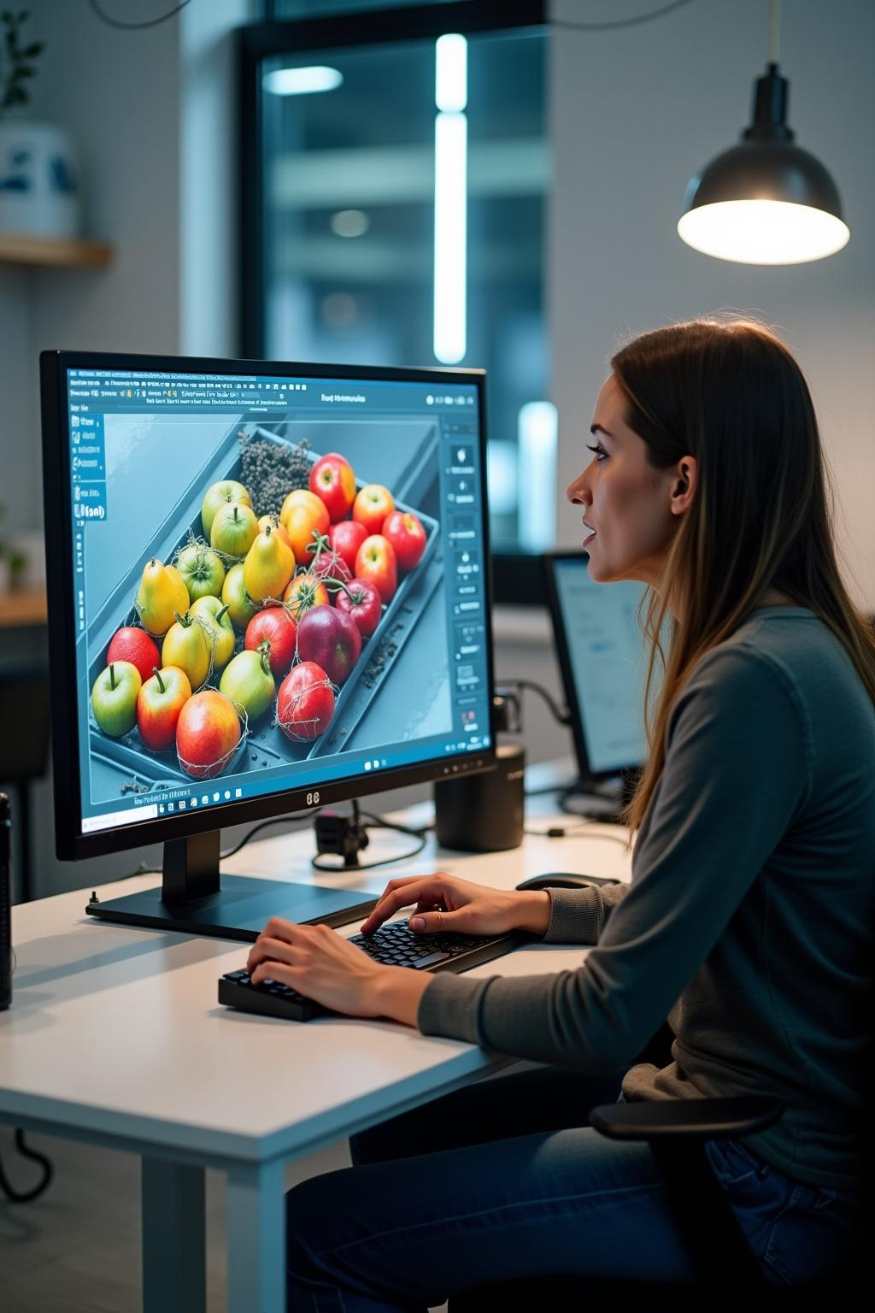
Application Development:
Frontend (User Interface)
Made using HTML, CSS, and Bootstrap
Pages:
index.html – Welcome page
about.html – Info about the project
predict.html – Upload image
output.html – Show result
Backend (Python + Flask)
Runs the project and handles the prediction
Receives the uploaded image and sends it to the model
Shows the result to the user
Model (VGG16 - AI Model)
Trained to detect fruits/vegetables and check if they are healthy or rotten
Saved in a file called healthy_vs_rotten.h5
How it works
User uploads an image
The image is sent to the model
The model predicts the result
The result is shown with the image

Slide 6
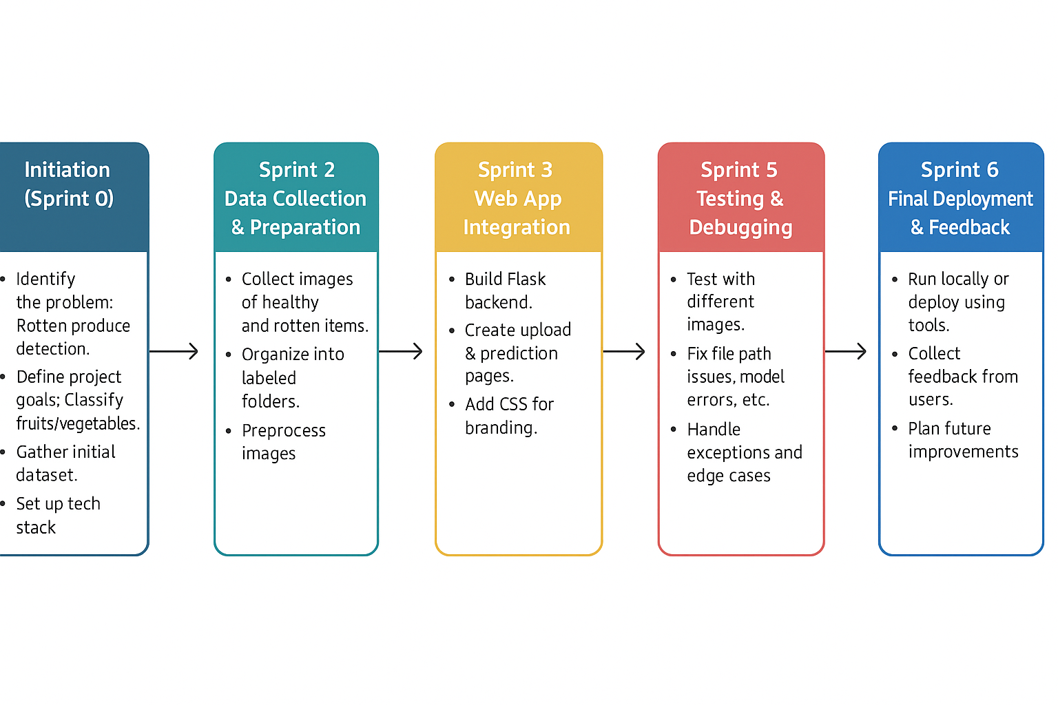

Slide 7
Overview of web app architecture
The architecture of the NutriGaze web application is designed to separate frontend and backend functionalities. The frontend is user-centric, offering a seamless interface for image uploads, while the backend processes these images using AI to deliver accurate sorting results.
[User]
⬇ Upload Image
[Frontend (HTML/CSS/JS)]
⬇
[Flask Web Server (app.py)]
⬇
[Model Prediction using VGG16]
⬇
[Output Display (Prediction + Image)]
⬇
[Result shown in output.html]

Slide 8
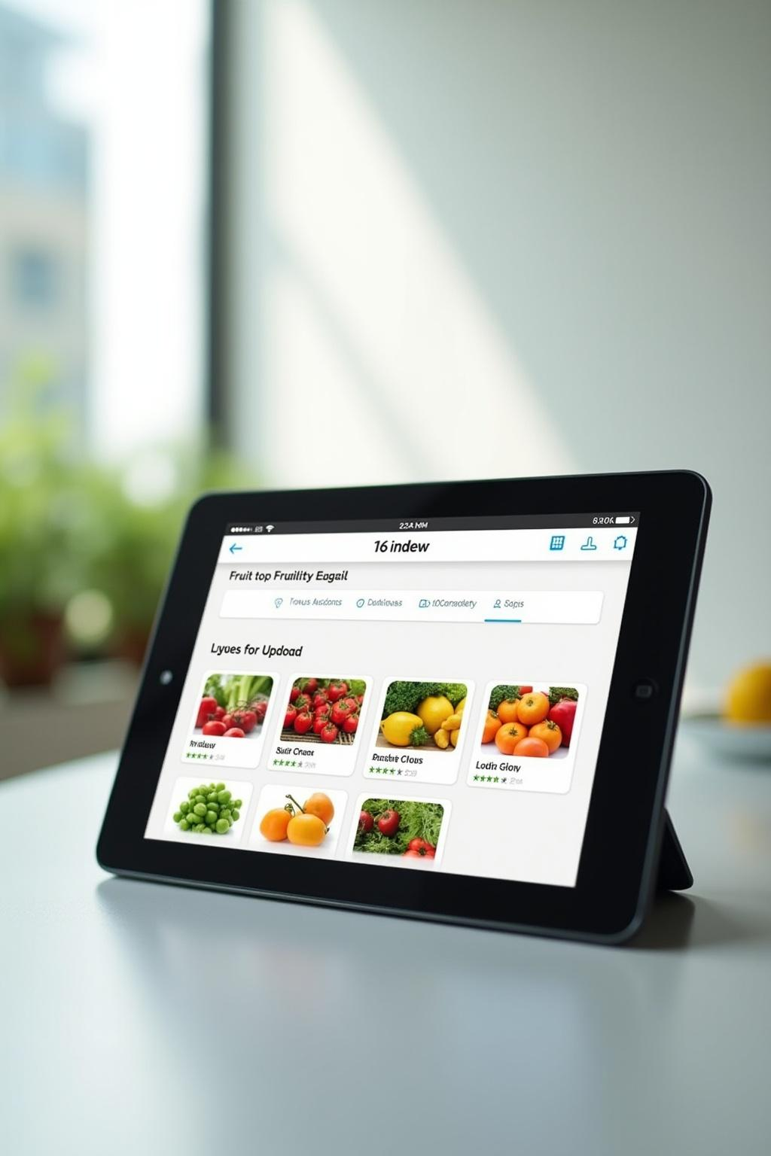
Frontend technologies used
The frontend of NutriGaze utilizes advanced web technologies such as HTML, CSS, and Bootstrap to create a responsive and user-friendly interface. This design allows users to easily upload images of fruits and vegetables for immediate analysis, ensuring a smooth interaction with the system.
Backend services and model integration:
NutriGaze's backend is built on the Flask framework, which efficiently manages server requests and data flow. It integrates machine learning models developed with TensorFlow/Keras, allowing for accurate predictions of fruit and vegetable quality based on image inputs.

Slide 9
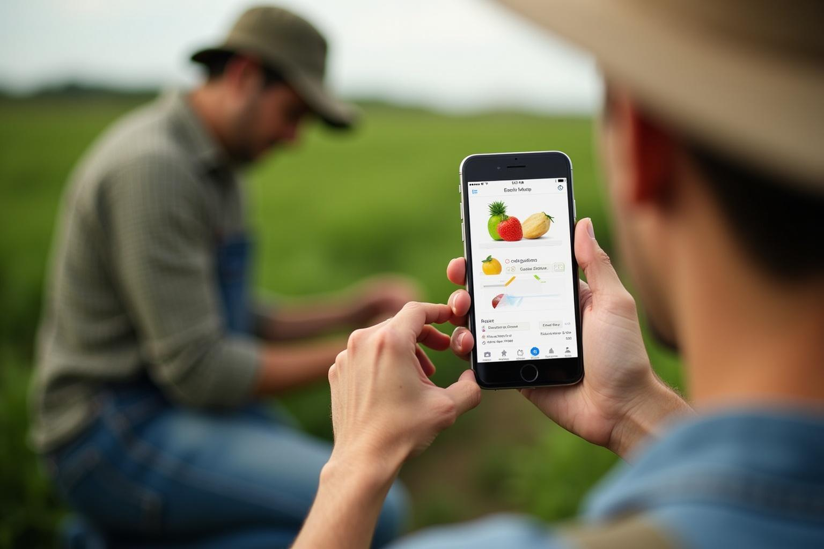
ADVANTAGES:
Quick Results
Shows if a fruit or vegetable is good or bad in seconds.
Less Wastage
Helps remove spoiled items early and avoid throwing away good produce.
Better Quality
Makes sure only fresh and healthy food is sold or used.
Helps Farmers and Sellers
Easy for them to check quality before selling.
Easy to Use Website
Just upload an image and see the result – no tech skills needed.
Gives Correct Answers
Uses smart AI to make accurate predictions.
Works Anywhere
Can be used on phones or computers in any location.
Low Cost
No need for expensive equipment.

Slide 10
Requirement analysis:
Functional Requirements 2. Non-Functional Requirements
📷 Image Upload ⚡ Performance
🧠 AI-Based Prediction 🛡️ Security
💬 Display Result 🎨 Usability
📁 File Storage 🔁 Scalability
3. User Requirements
Basic knowledge of uploading files on the web.
A device with a browser (mobile or desktop).
No installation required; runs in a browser.

Slide 11
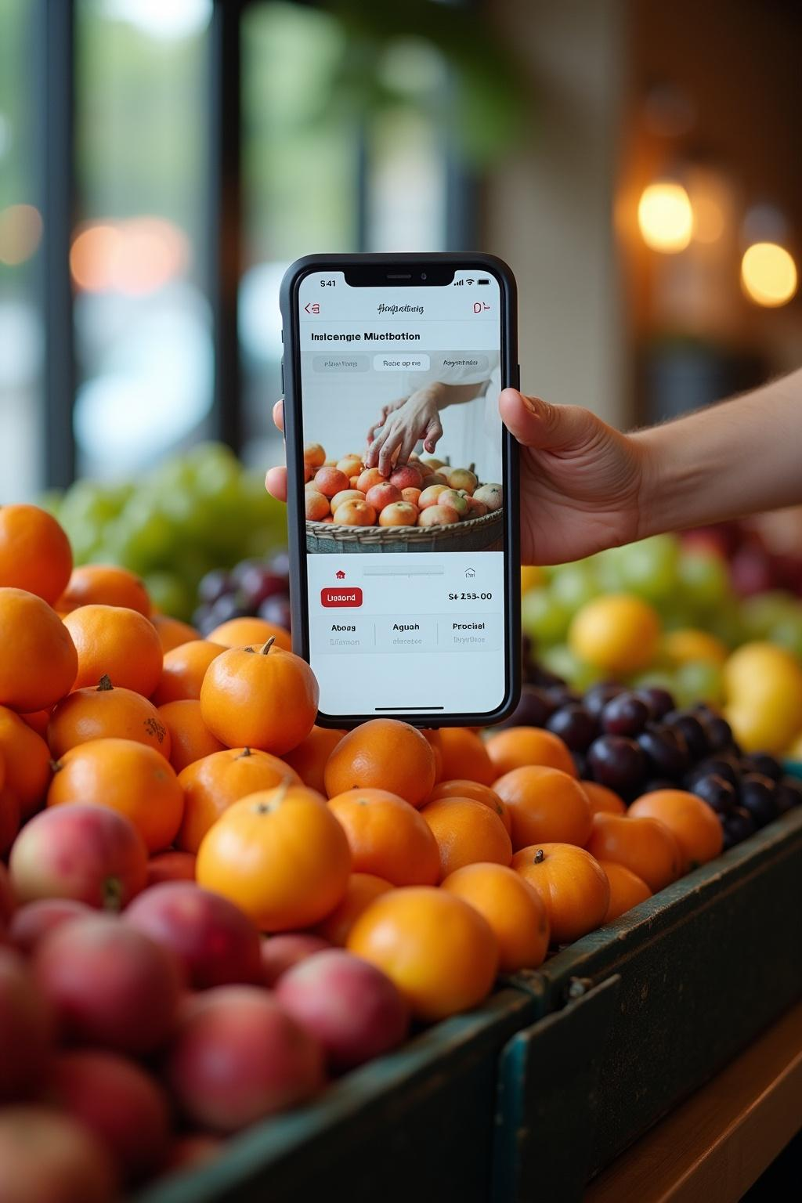
CONCLUSION:
The Smart Sorting System makes it easy to check whether fruits and vegetables are healthy or rotten using just a photo. It uses AI and deep learning to give quick and accurate results, helping farmers, shopkeepers, and customers avoid waste and ensure better food quality. It is easy to use, cost-effective, and helpful in daily life, making it a valuable tool for the future of agriculture and food safety

Slide 12
THANK YOU

